Slide 1
Phishing Training

Slide 2
Introduction
The purpose of this document is to educate all users within the company on how to protect themselves from phishing.
Phishing is a widely used method of accessing some sort of currency, (whether data, information, or financial currency,) in a malicious way.
To do this, they attempt to disguise their emails as legitimate to either convince the recipient to complete a malicious task, or they attach malicious files to the email in an attempt to give the recipient a virus that can potentially affect the entire network.
It is important that every user is aware of the indicators of phishing, and how to act if phishing is suspected.

Slide 3
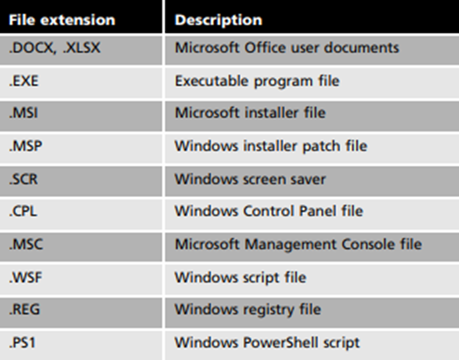
Spotting Phishing Emails
As a result of previous phishing attacks, [redacted]. Always verify that the email address matches the name in the email. This way, if someone is trying to represent themselves as someone in the company, it will be an easy distinction if it is fake, as [redacted].
In general, if you receive an email you were not expecting, it is always important to take precautions. For example, always verify that if a company is involved, that that company actually exists and the person claiming they are from that company is actually who they say they are.
Another precaution one should use is to read over the email and see if it even makes sense. It is very important not to open up any attachments before reading the email and making a sound judgement as to whether or not the file is safe to open. Even if a file appears as though it is harmless, or if it is a known file type, it may be malicious. The following are examples of Windows file types that can possibly be infected:

Slide 4
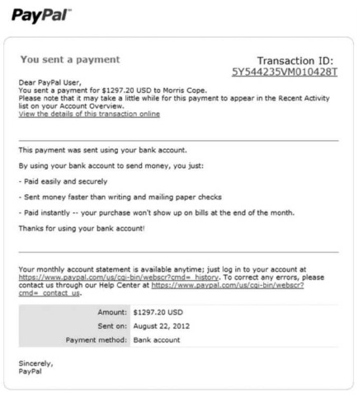
Spotting Phishing Emails Continued
Another method that used by attackers is to motivate you to use an external website link for a variety of reasons. For example, they may ask you to go to their provided link and log in to something you are actually familiar with. However, just because the website seems correct, does not mean it is what it appears to be. Avoid clicking on links in emails and go directly to the website via its’ actual website address typed into the search bar.
In this example, this email is created to look like a legitimate email from PayPal. However, the link
is not an actual PayPal link. If the users enter their
information into this fake website, the attackers
collect this potentially sensitive information to
use maliciously.
Common features of phishing attacks are:
- Deceptive web links
- Logos (to try and resemble a legitimate company)
- Urgent requests (to try and pressure the
recipient)

Slide 5
Phishing IQ Test
The following link is a test to see whether or not you can accurately determine what is and is not a phishing email.
It will display different examples of legitimate emails and phishing emails and ask you to determine whether or not they are legitimate. It will also explain, if you did choose an incorrect answer, why the answer you chose was incorrect.
With this, you can understand where you stand in your knowledge of phishing.
www.sonicwall.com/phishing-iq-test/

